Slide 1
An introduction to Speech
CS425

Slide 2
Representations of speech signals
The representations for speech signals on a computer can be classified into two broad groups:
Waveform representations – these are concerned with preserving the “wave shape” of the analog speech signal through a sampling and quantisation process
Parametric representations – these are concerned with representing the speech signal as the output of a model for speech production

Slide 3
Parametric representation
The first step is to obtain a digital waveform representation by sampling using an ADC
Further processing is then used to obtain the parameters of the model for speech production
The parameters of the model can be further classified such as excitation parameters (i.e. related to the source of the speech sounds) or vocal tract response patterns (i.e. related to the individual speech sounds)

Slide 4
Some Problems Sources
The assumption that speech is short time stationary
The formulation or choice of a suitable feature vector representation that will capture accurately the important information in the speech signal for future processing

Slide 5
Speech Production Process
The sounds and transitions in the speech signal serve as a symbolic representation of the information
The arrangement of the sounds is governed by the rules of language
The study of these rules and their implications in human communications is the science of linguistics
The study and classification of the sounds of speech is called phonetics

Slide 6
Mechanism of Speech production
The vocal tract begins at the opening between the vocal cords, or glottis and ends at the lips
It consists of the pharynx (the connection from the esophagus to the mouth) and the mouth or oral cavity
In the average male, the vocal tract length is about 17cm, for the average female it is about 14cm and for a child it is about 10cm

Slide 7
Mechanism of Speech production
The nasal tract begins at the velum and ends in the nostrils
When the velum is lowered, the nasal tract is acoustically coupled to the vocal tract to produce the nasal sounds of speech

Slide 8
Mechanism of Speech production
The sub-glottal system is composed of the lungs, bronchi and trachea
This sub-glottal system serves as a source of energy for the production of speech
Speech is the acoustic wave that is radiated from this system when air is expelled from the lungs and the resulting flow of air is perturbed by a constriction somewhere in the vocal tract

Slide 9
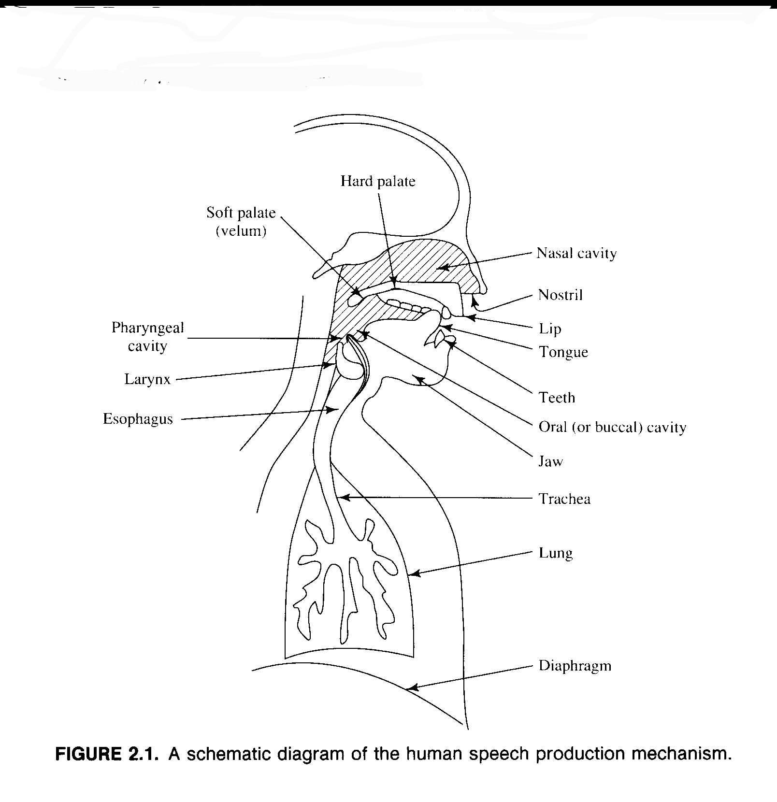

Slide 10
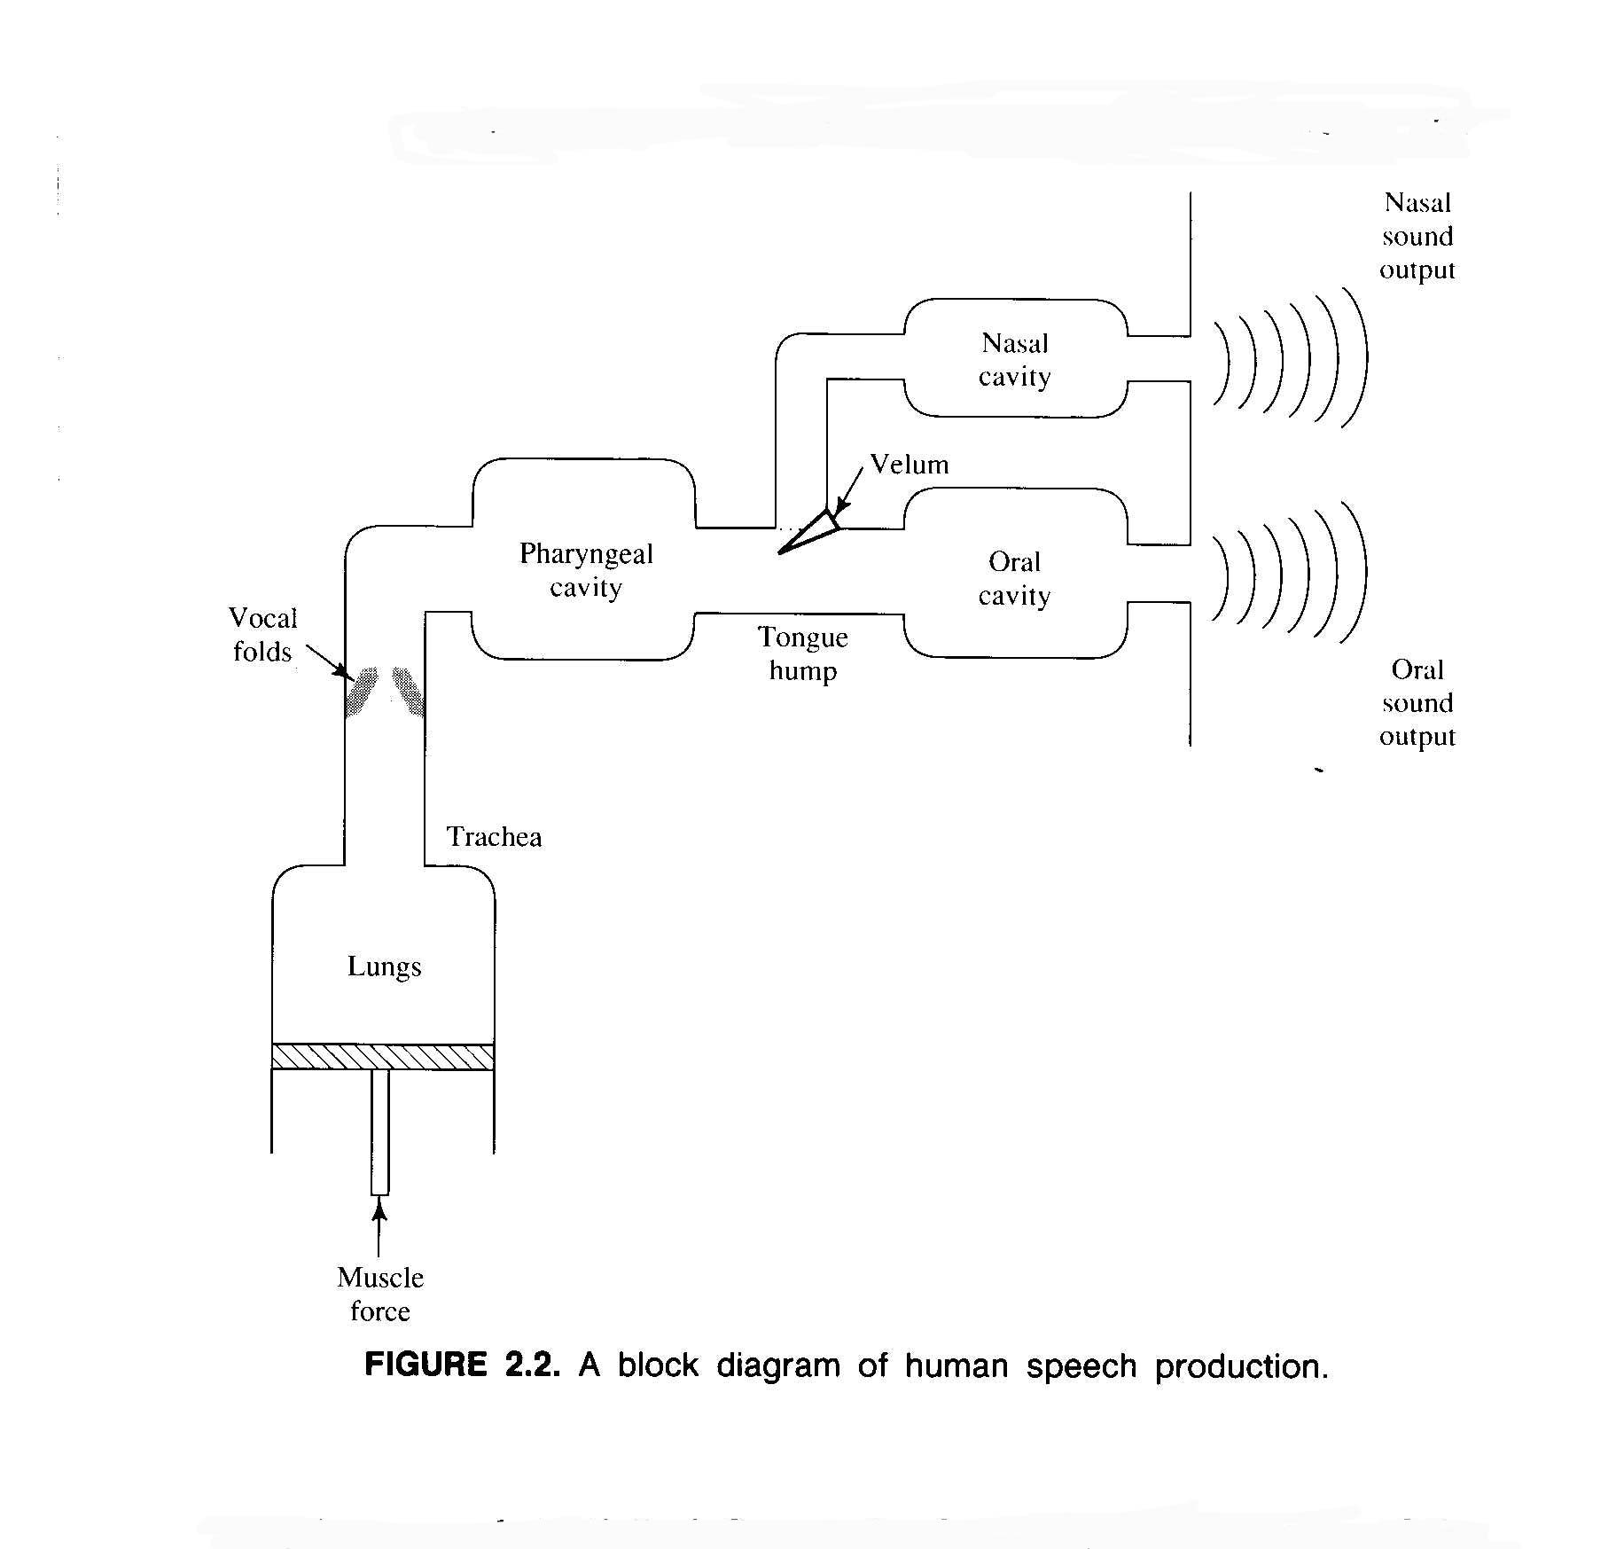

Slide 11
Speech Sounds - Voiced
Speech sounds can be classified into two distinct classes according to their mode of excitation
Voiced sounds are produced by forcing air through the glottis with the tension of the vocal cords adjusted so that they vibrate in a relaxation oscillation, thereby producing quasi-periodic pulses of air which excite the vocal tract
Voiced segments are labelled /U/, /d/, /w/, /I/ and /e/

Slide 12
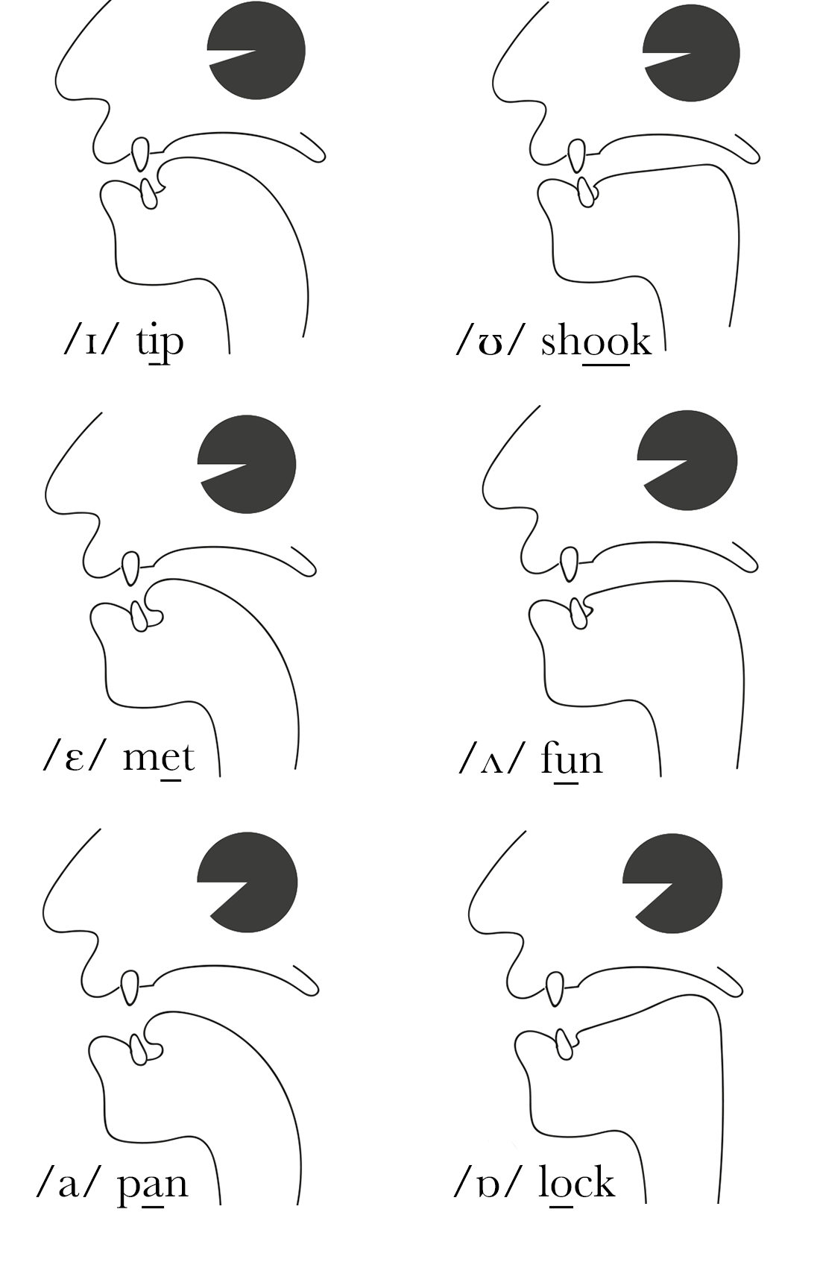
Short vowels are a group of single positioned (monophthong) sounds that are characterised by generally being shorter in length than long vowel sounds and diphthong vowel sounds. Standard English has 6 short vowel phonemes:
Common spellings for each short vowel sound are underlined below:
/ɪ/ fit, English, mystery
/ʊ/ push, hood, could
/ɛ/ red, breath, many
/ʌ/ cut, come, enough
/a/ hat
/ɒ/ lost, watch, Australia

Slide 13
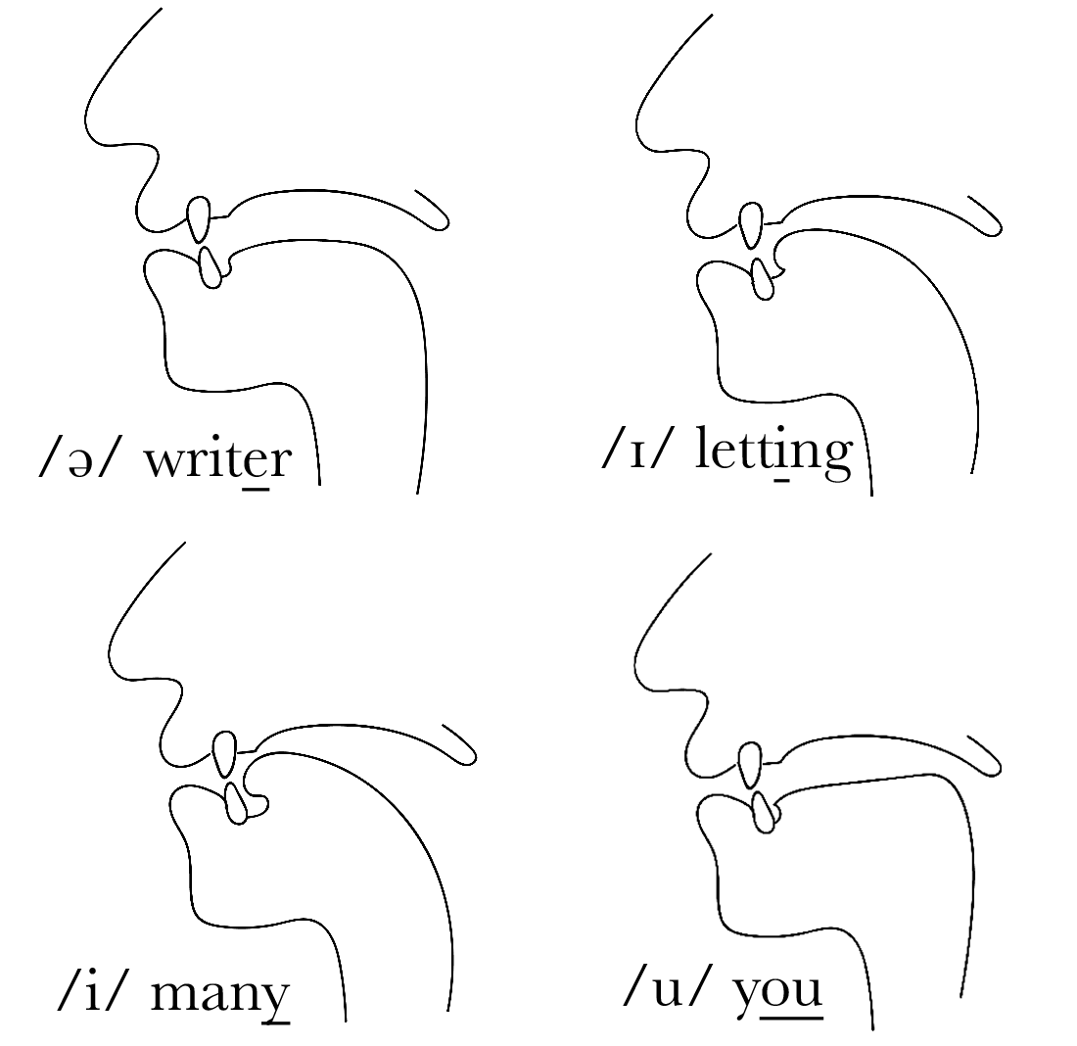
Weak vowel sounds are found in unstressed syllables in English pronunciation. In standard pronunciation there are 4 weak vowel sounds (in order of frequency) /ə,ɪ,i,u/:
Common spellings for each weak vowel sound in content words are underlined below:
/ə/ annoy, tighter, council, obstruct, submit
/ɪ/ insure, repeat, cottage
/i/ sunny

Slide 14
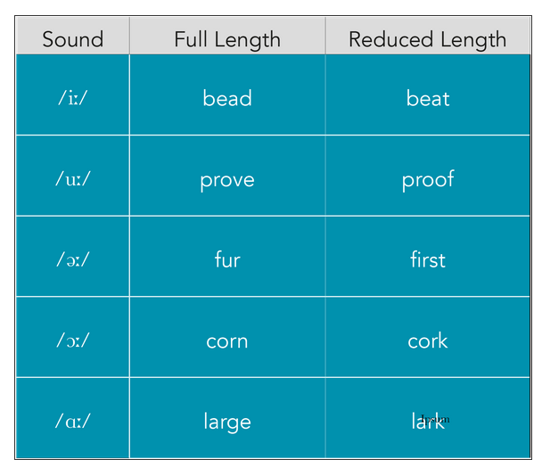
Long vowel sounds are shortened if the following sound is a voiceless consonant: /p,t,k,f,θ,s,ʃ,tʃ/.
These are known as reduced vowels.

Slide 15
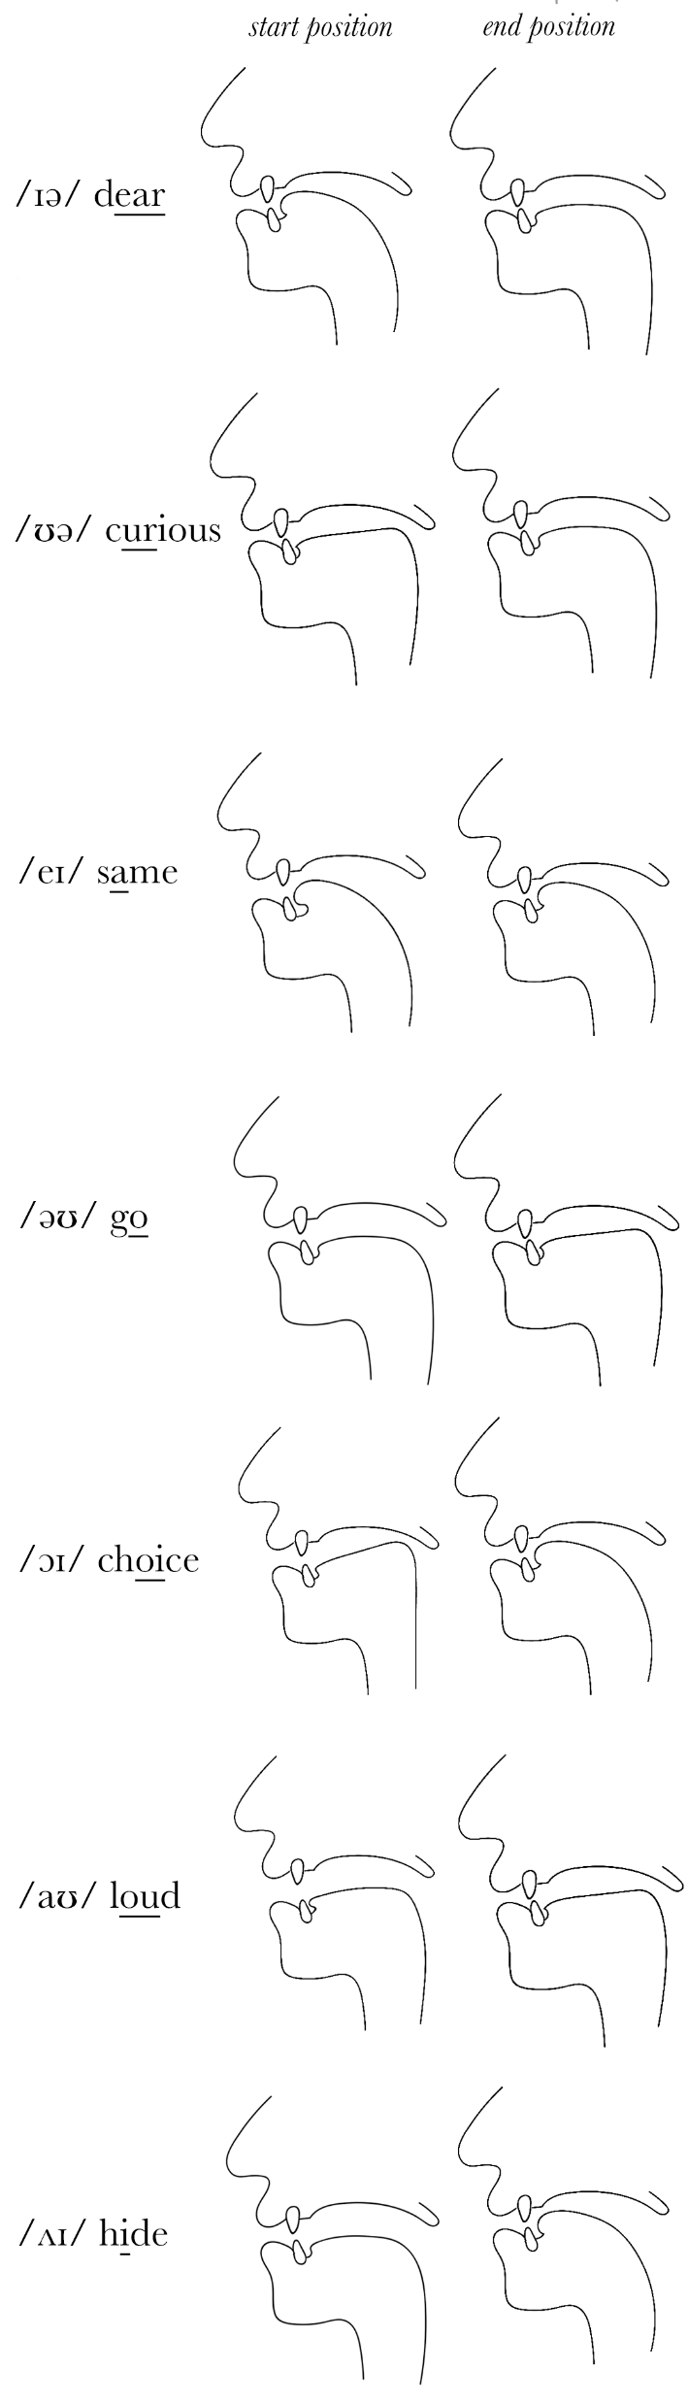
Diphthongs are long vowel sounds that start in one position of the mouth and end in another within the same syllable. Standard English pronunciation has 7 diphthong phonemes
Diphthong Vowel Sound Spellings
Common spellings for each diphthong vowel sound are underlined below:
/ɪə/ zero, clear, beer
/ʊə/ cure, poor
/eɪ/ face, main, day
/əʊ/ home, grow, load
/ɔɪ/ coin, joy
/aʊ/ sound, town
/ʌɪ/ find, pie, cry

Slide 16
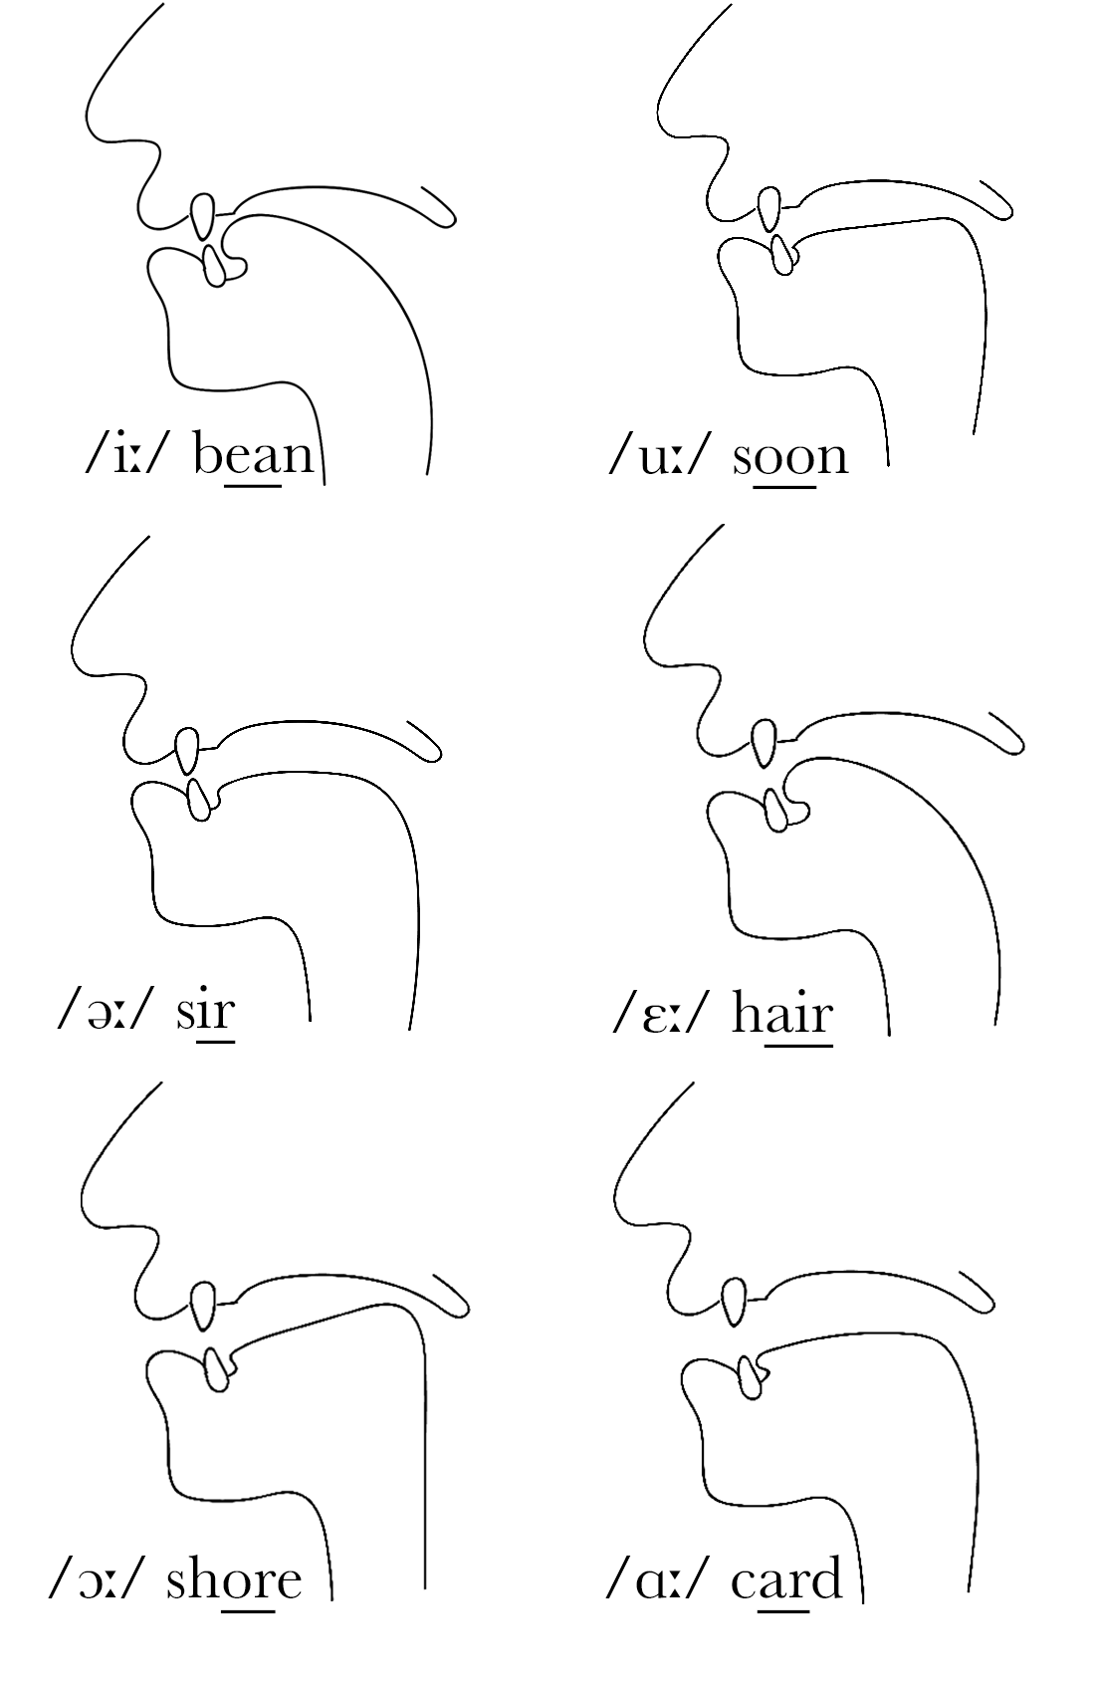
Standard English pronunciation has 6 long vowel phonemes:
Common spellings for each long vowel sound are underlined below:
/iː/ sheet, leaf, niece
/uː/ few, mood, two
/əː/ first, burn, worst
/ɔː/ fall, paw, sort
/ɛː/ dare, hair, bear
/ɑː/ far, dance*, palm

Slide 17
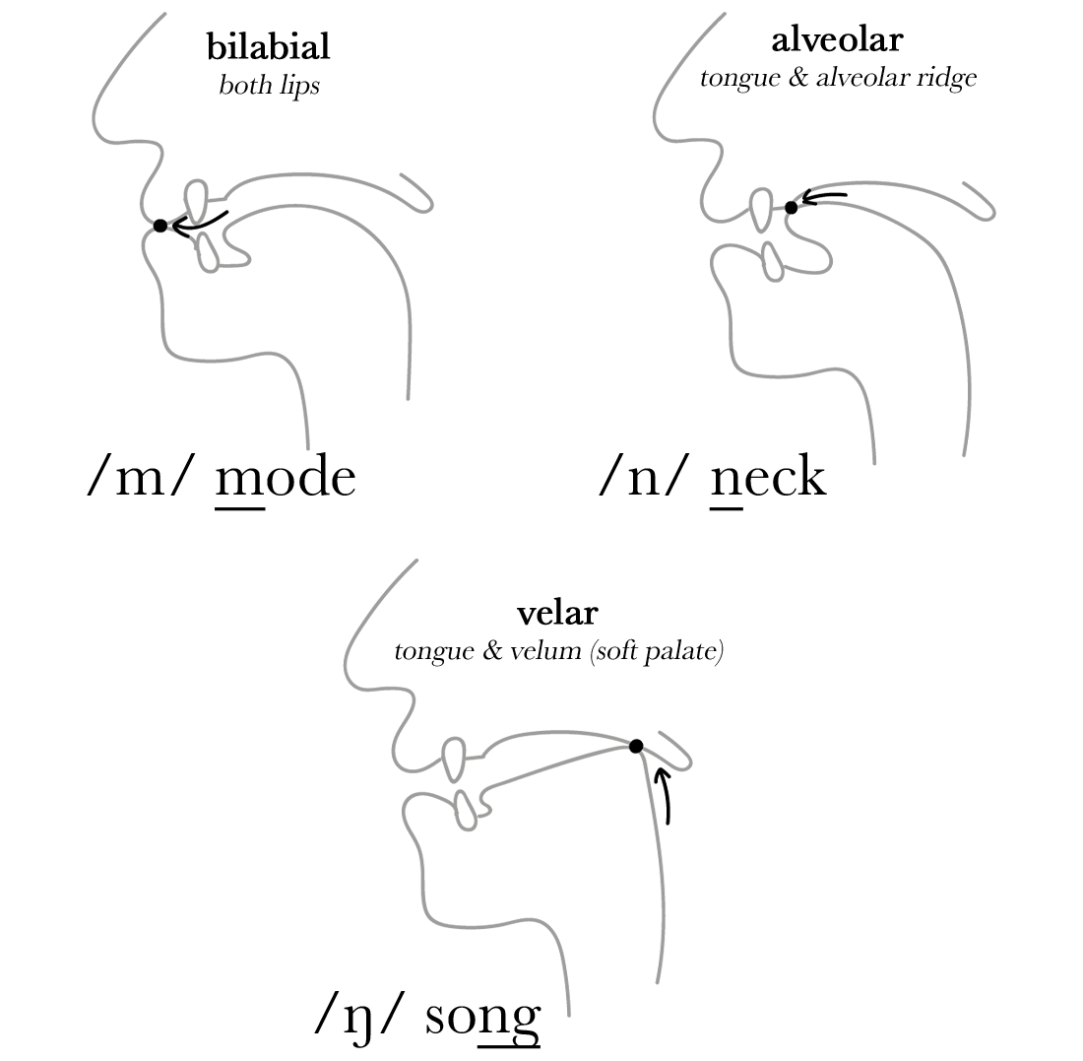
Nasal consonant sounds are made by blocking air in the mouth and releasing sound through the nose. English pronunciation has 3 nasal phonemes:
All of these nasal consonant sounds are voiced, the vocal cords vibrate throughout.
Nasal Spellings
Spellings for each nasal sound are underlined below:
/m/: same
/n/: next
/ŋ/: working, think

Slide 18
Vowel Example
Time Waveform

Slide 19
Formants Emphasised

Slide 20
Harmonics Emphasised

Slide 21
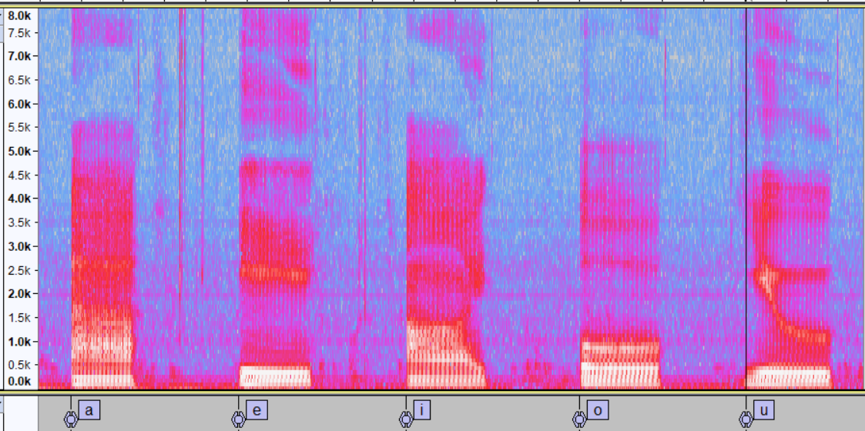
Vowels with formants indicated in the spectrogram

Slide 22
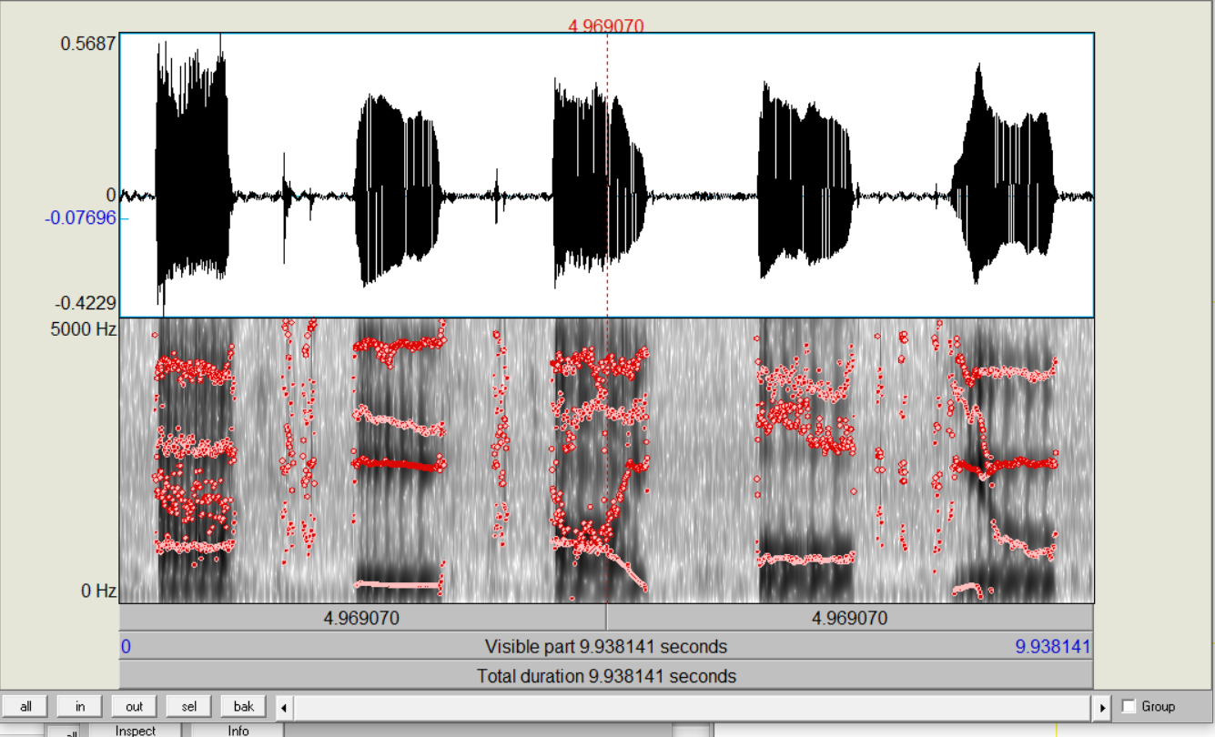
Formant Tracking Example using Pratt

Slide 23
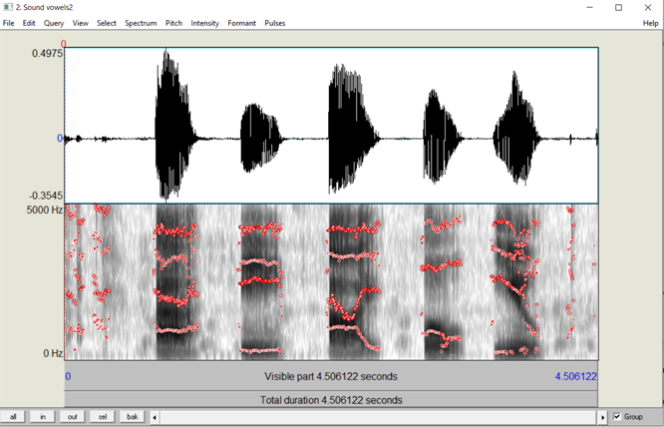
Another Formant Tracking Example using Pratt

Slide 24
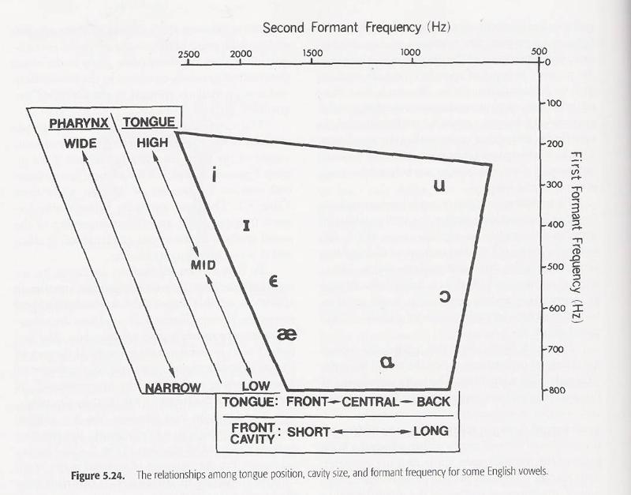

Slide 25
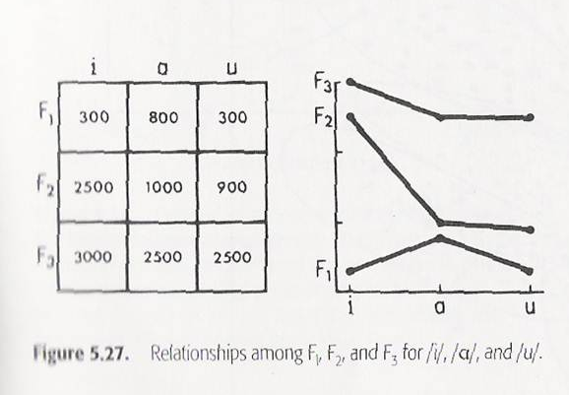

Slide 26
Speech Sounds - Fricatives
Fricative or unvoiced sounds are generated by forming a constriction at some point in the vocal tract (usually toward the mouth end) and forcing air through the constriction at a high enough velocity to produce turbulence
This creates a broad-spectrum noise source to excite the vocal tract. There are nine fricative sounds in English
An example is the /s/ sound in six

Slide 29
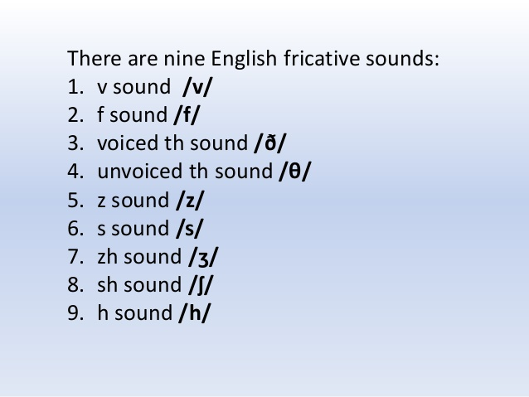

Slide 30
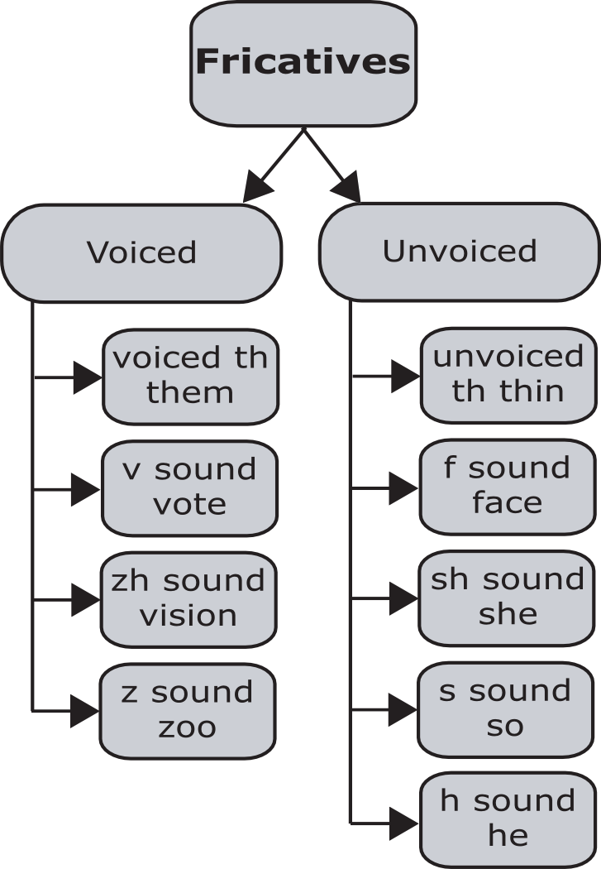

Slide 31
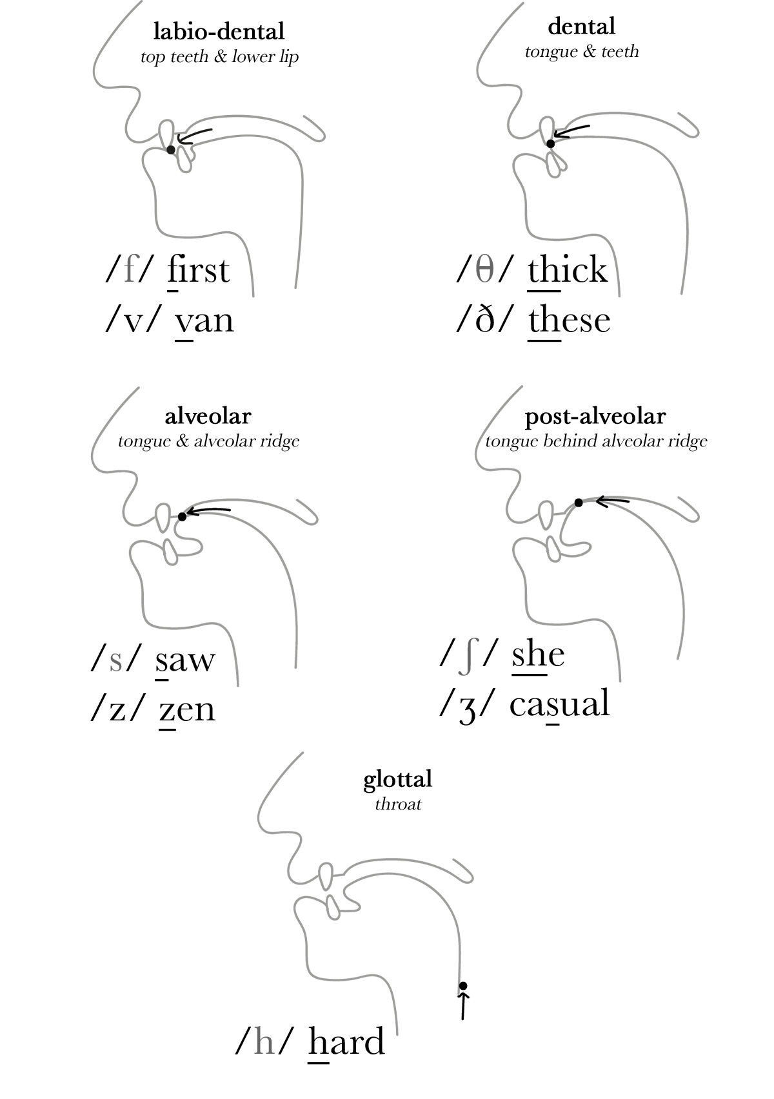
The fricative sounds /v,ð,z,ʒ/ are voiced, they are pronounced with vibration in the vocal cords, whilst the sounds /f,θ,s,ʃ,h/ are voiceless; produced only with air.
Fricative Sound Spellings
Common spellings for each fricative sound are underlined below:
/f/: far /v/: save, of /θ/: think /ð/: those /s/: sir, race /z/: zoo, rise /ʃ/: sharp, chef, pressure, sugar, motion /ʒ/: beige, Asia, pleasure /h/: ahead

Slide 32
Speech Sounds - Others
Four other types of excitation, which are really just combinations of voiced, unvoiced and silence are usually delineated for modelling and classification purposes
These are (1)mixed, (2) plosive, (3)whisper, and (4) silence
A sound may be simultaneously voiced and unvoiced (mixed)
For example, consider the sound corresponding to the letter /z/ in the phrase ‘Three zebras’

Slide 33
Speech Sounds - Plosive
Some speech sounds are composed of a short region of silence, followed by a region of voiced speech, unvoiced speech or both
These Plosive sounds result from making a complete closure (normally towards the front of the vocal tract), building up a pressure behind the closure and abruptly releasing it

Slide 34
Speech Sounds - Plosive
An example of Plosive excitation is (silence + unvoiced) is the sound corresponding to /t/ in ‘pat’
Another (silence + voiced) is the /b/ in ‘boot’ in which the voicing for the “oo” /u/ vowel is turned on immediately after the release of pressure

Slide 35
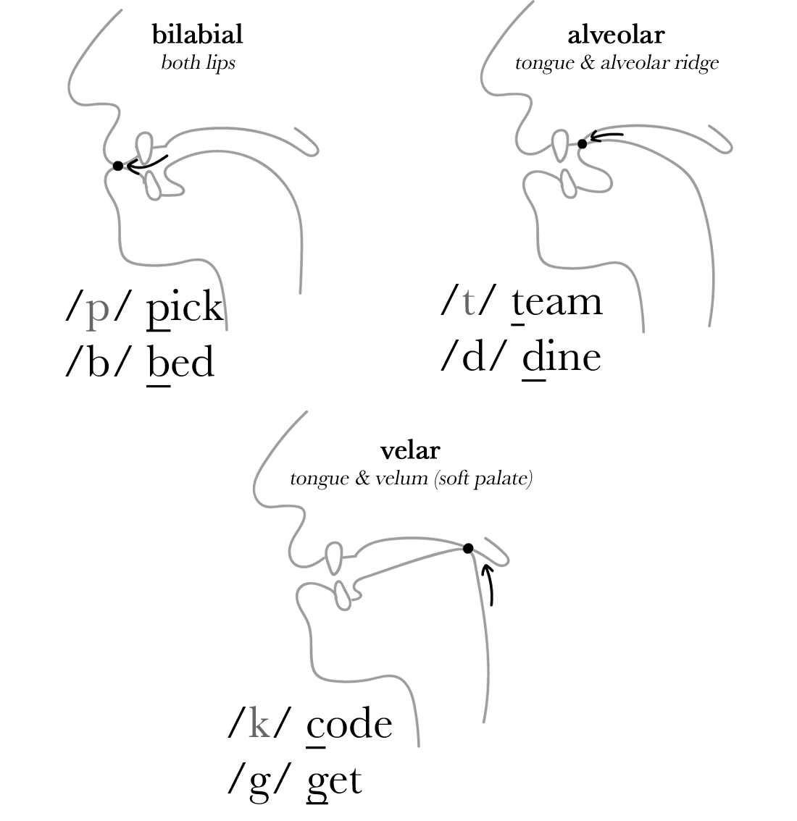
Plosive consonants are made by completely blocking the flow of air as it leaves the body, normally followed by releasing the air.

Slide 36
English pronunciation contains 6 plosive phonemes: /p,b,t,d,k,g/:
The sounds /b,d,g/ are voiced; they are pronounced with vibration in the vocal cords. /p,t,k/ are voiceless; they are produced with air only. The voiceless plosives are often aspirated (produced with a puff of air) in English pronunciation.
Plosive Spellings
Common spellings for each plosive are underlined below:
/p/: purse
/b/: bell
/t/: talk, stopped
/d/: done, played
/k/: kite, cone, queen, chronic, excited
/g/: gone, exhaust

Slide 37
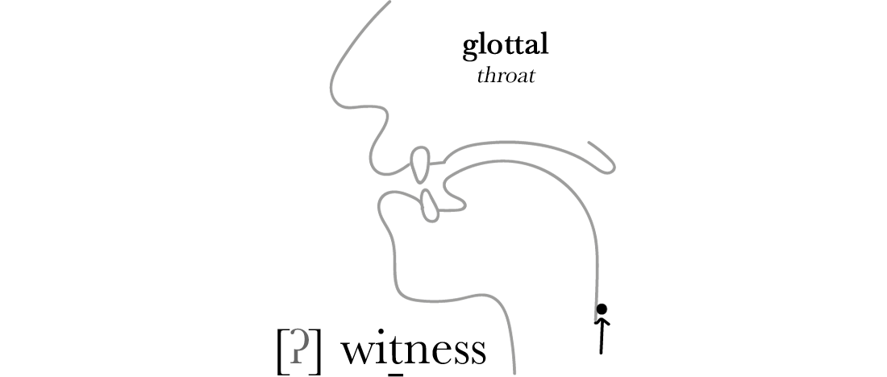
The voiceless alveolar plosive sound /t/ is often replaced with a voiceless glottal plosive in connected speech. This most frequently occurs when /t/ appears at the end of a syllable and the following sound is a consonant:

Slide 38
Voice Production
Voiced excitation occurs when the abdominal muscles force the diaphragm up, pushing out air from the lungs into the trachea, then up to the glottis, where it is periodically interrupted by the movement of the vocal folds
The repeated opening and closing of the glottis is in response to subglottal air pressure from the trachea

Slide 39
Voice Production - Pitch
The time between successive vocal fold openings is called the fundamental period T₀, while the rate of vibration is called the fundamental frequency of the phonation

Slide 40
Voice Production - Pitch
This fundamental period is evident in the speech waveform and it is dependent on the size and tension of the speaker’s vocal folds at any given instant
Since the average size of the vocal folds is greater in men than women, the average fundamental frequency of an adult male speaking an utterance will be lower than a female’s

Slide 41
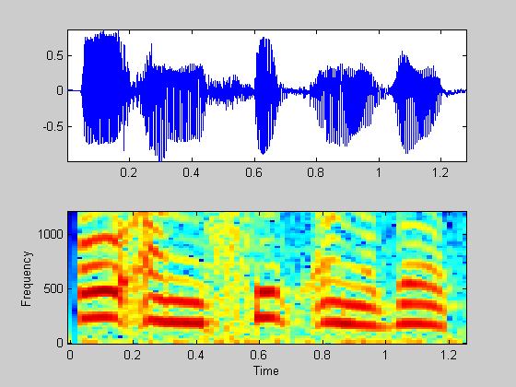
Female Speech Example

Slide 42
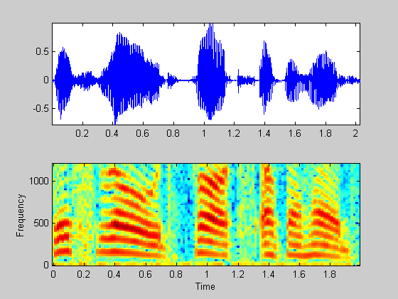
Male Speech Example

Slide 43
Voice Production – Pitch & Fundamental Freq
The term pitch is often used interchangeably with fundamental frequency. However, there is a subtle difference
Psycho-acousticians use the term pitch to refer to the perceived fundamental frequency of a sound, whether or not that frequency is actually present in the waveform

Slide 44
Voice Production – Pitch & Fundamental Freq
Speech transmitted over landlines is usually bandlimited to about 300-3000Hz.
Nevertheless, a person who is phonating at 100Hz will be perceived as such by the listener, even though the fundamental frequency of the waveform cannot be less than 300Hz. Thus, while the pitch of the received waveform is 100Hz, its actual fundamental frequency is 300Hz
Generally, though in speech processing the word pitch is taken to mean fundamental frequency

Slide 45
Voice Production - Pitch
Everyone has a pitch range to which they are constrained by the simple physics of their own larynx
For men, the possible pitch range is between the two bounds 50-250Hz, while for women the range usually falls somewhere in the interval 120-500Hz
Everyone has a habitual pitch level, which is the preferred pitch that will be used naturally on average

Slide 46
Voice Production – Pitch & Prosody
Pitch is shifted up and down when speaking in response to factors relating to stress, intonation and emotion

Slide 47
Voice Production - Prosody
Stress refers to a change in fundamental frequency and loudness to signify a change in a syllable, word or phrase
Intonation is associated with the pitch contour over time and performs several function in a language, the most important being to signal grammatical structure
The markings of sentence, clause, and other boundaries is accomplished through intonation patterns

Slide 48
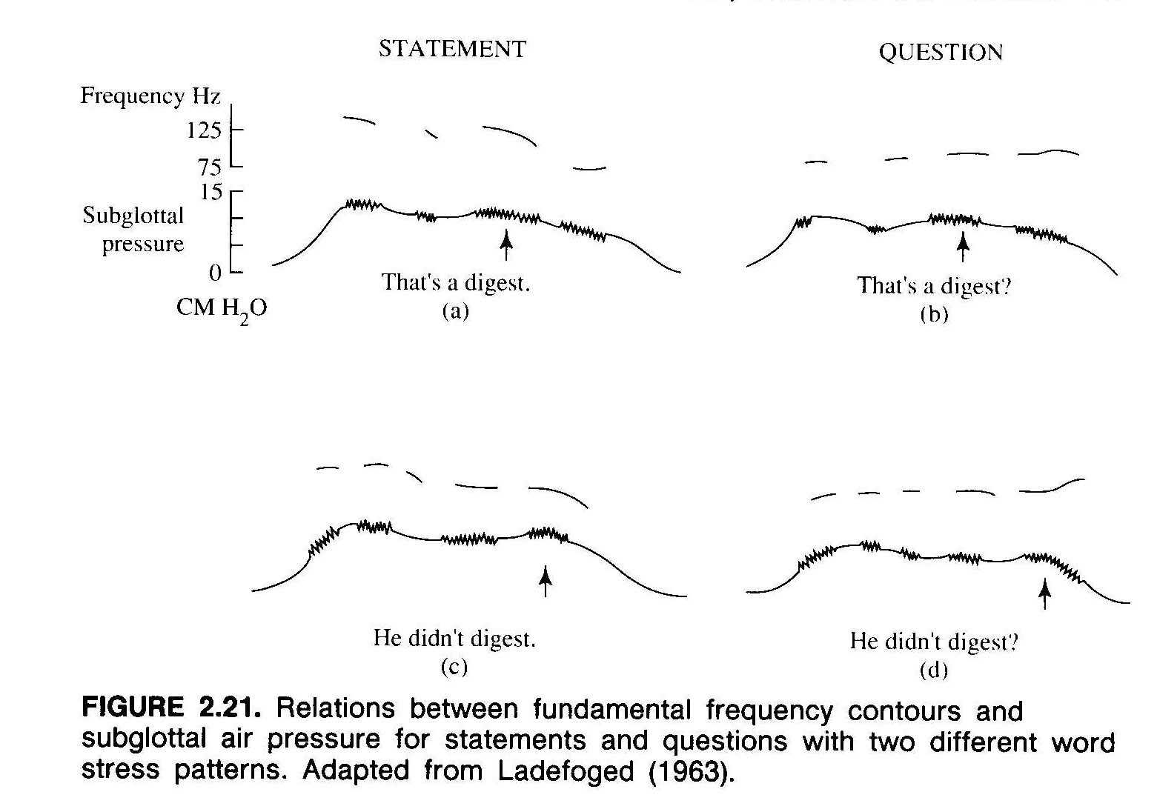

Slide 49
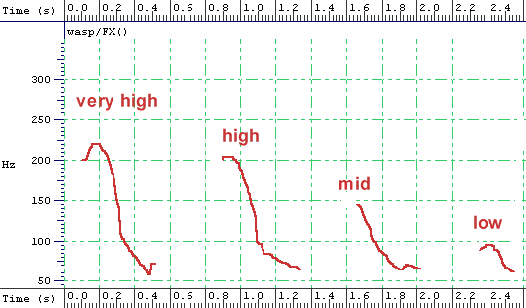
Pitch contour for the word no spoken with different intonation

Slide 50
Formants
As the sound generated propagates down the tubes formed by the vocal and nasal tracts, the frequency spectrum is shaped by the frequency selectivity of the tube (like in an organ)
The resonance frequencies of the vocal tract tube are called formant frequencies or simply formants
The formant frequencies depend upon the shape and dimensions of the vocal tract

Slide 51
Formants
Different sounds are formed by varying the shape of the vocal tract
Thus, the spectral properties of the speech vary with time as the vocal tract shape varies

Slide 52
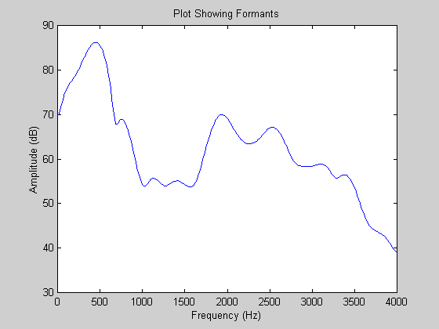
Formants

Slide 53
Spectrogram
The time-varying spectral characteristics of the speech signal can be graphically displayed using a spectrogram
Using a short window the resonance frequencies of the vocal tract show up as dark bands
Voiced regions are characterised by a striated or narrow appearance due to periodicity in the waveform, while unvoiced intervals are more solidly filled in

Slide 54
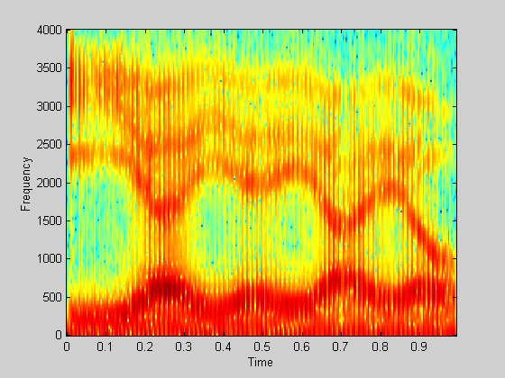

Slide 55
